Slide 1

HACKATHON PRESENTATION
TEAM MARY WILKES
Lilian Peterson
Juanita Palomar
Adeola Adesoba

Slide 2
HACKATHON’S MISSION STATEMENT
The mission of this hackathon was to predict a virtual machine learning hackathon to battle Covid-19
We are also required to put our newfound skills in the battle against COVID-19

Slide 3
PROBLEM STATEMENT
The team brainstormed and produced a problem statement: to predict the number of people who are likely to contact Covid-19 based on their age, county and gender respectively.
Our goal is to predict deaths due to COVID-19

Slide 4
DATA DESCRIPTION
The data originated from www.floridahealth.gov/newsroom as a PDF file
The data is a snapshot of the Covid-19 situation in Florida as of July 16,2020
The data contains both Cases of Covid-19 and Deaths due to Covid-19 as of July 16, 2020.

Slide 5
DATA DESCRIPTION CONT’D
The Florida Department of Health website publishes a pdf file of persons infected with COVID-19 and persons who have passed with COVID-19. The file is updated daily. We took a snapshot of the data on July 16, 2020 and created a csv datafile with the data. Our goal is to predict deaths due to COVID-19.
Here are the list of the features and their possible values:
AGE: Minimum of 0. Maximum of 119. Integer values in the range [0,119]
GENDER: Female, Male
COUNTY: There are 67 counties in Florida plus an additional label of “Unknown” included by the FL Dept of Health which makes a total of 68 counties
MONTH: 12months. January, February, March, April, May, June, July, August, September, October, November, December
DAY: Integer values in the range[1,31]
OUTCOME: Case, Death

Slide 6
DATA QUALITY ISSUES
The data contains some unknown records
Incomplete data set that could affect the quality of result obtained
Errors in dataset that could not be verified

Slide 7
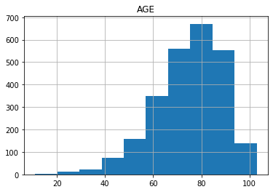
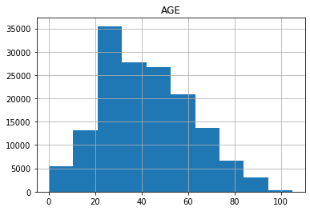
Histogram Plot – Male Deaths and Cases
The average age of all Male deaths from COVID-19 is 74.9 years old and the total number of Male deaths is 2542
The average of all Male cases with COVID-19 is 41.6 years old and the total number of Male cases is 153012

Slide 8
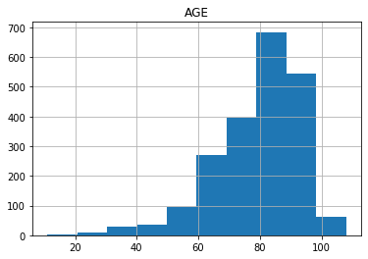
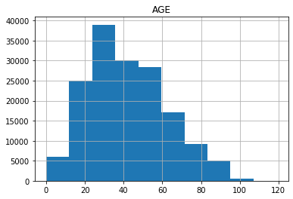
Histogram Plot – Female Deaths and Cases
The average age of all Female deaths from COVID-19 is 79.5 years old and the total number of Female deaths is 2126
The average age of all Female cases from COVID-19 is 42.0 years old and the total number of Female deaths is 160076

Slide 9
Count of Cases by County

Slide 10
Count of Outcome by Age and County

Slide 11
Cases by Gender

Slide 12
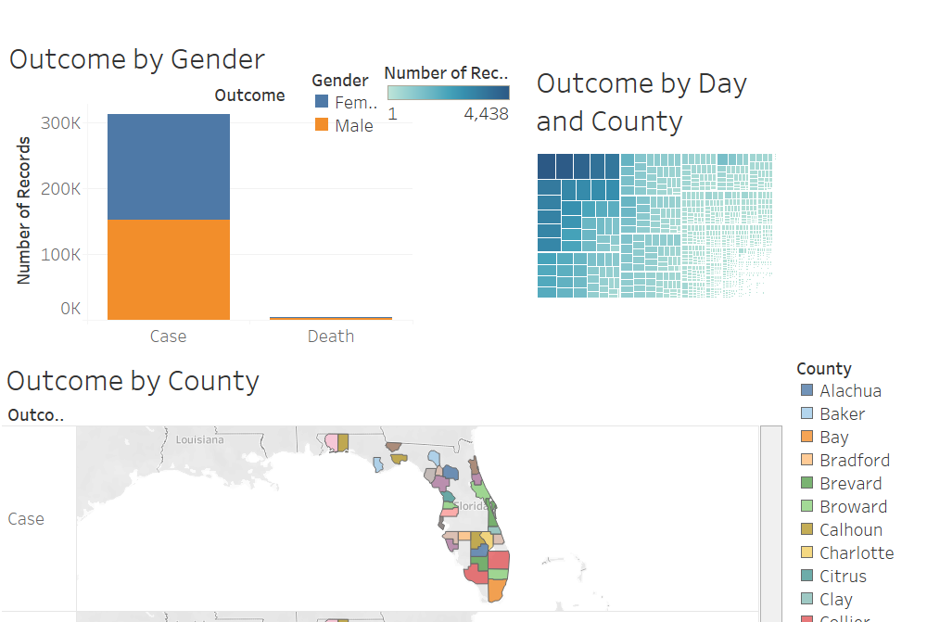
Tableau Dashboard

Slide 13
MODELLING AND ALGORITHMS
A Sagemaker Linear Learner Model to predict the outcome of COVID-19 by Gender, Age, County was run using ml-m4-xlarge
It took about 1032 secs to train the data
The trained model was stored in a S3 bucket and deployed
The model was overfitted due to the low proportion of death to cases
As a result of the overfitting, we recorded an accuracy of 99.99%

Slide 14
CONCLUSION
The model was overfitted due to the data ratio
To correct the proportion, we could use data with age greater than 80 years old

